Slide 1
An introduction to writing code for humans
A clean code primer
Notes:
Advanced warning of expletives, quick introduction to clean code; summarise that clean code is a term used for writing code that is well tested, self documenting and nice to read
Examples in C#
1

Slide 2
Introduction
Email: scott.tippett@bt.com
Currently working in “Directories”
Always have time to discuss clean code and agile development
Notes:
Blah blah blah, me me me.
2

Slide 3

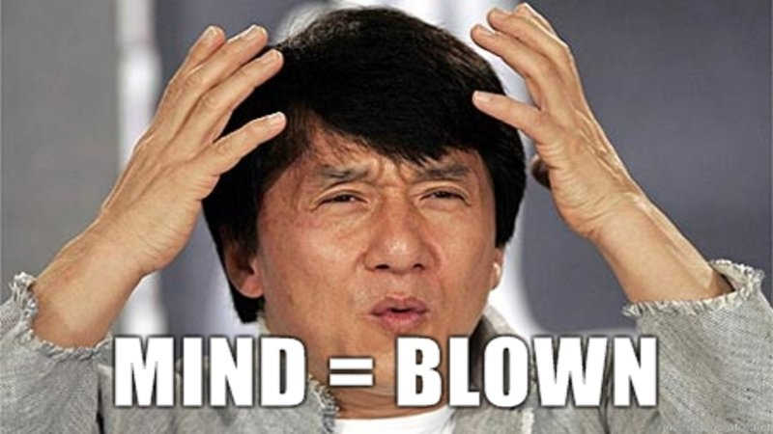
Think about it
All code is technical debt
Notes:
Code is complex, the more of it you write the more of it you have to maintain. Maintaining code takes time, and time is money, money which we have to pay in future; therefore all code is tech debt
3

Slide 4
Why write cleaner code?
It’s simple, really
Reduce time spent understanding
Minimise complexity
Notes:
Lol, simple – get it as we’re trying to make it simple and the process is simple too
Reducing the time spent understanding a problem is simple, make the solution describe itself so you can easily dive into the level of detail you need
Complexity is not something that belongs in code, sure problems can be complex but it’s our job as programmers to make it look elegant
4

Slide 5
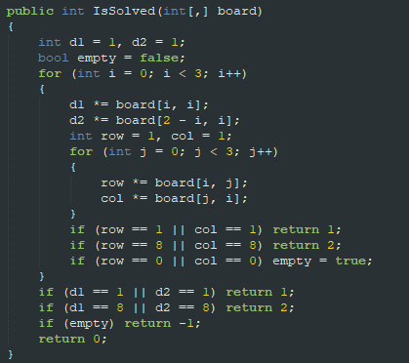
What does this do?
Notes:
Give 30 seconds to examine code
5

Slide 6
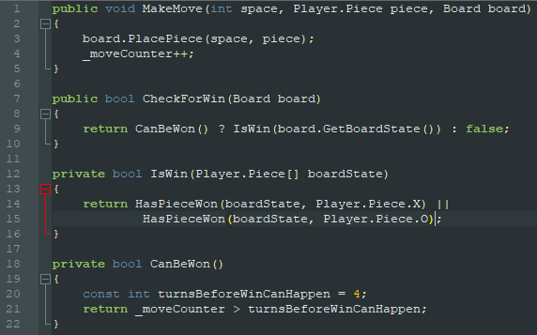
It does the same as this
Notes:
This isn’t the best it could be, but it’s a whole lot more descriptive of what it’s doing than the previous one. We can tell it’s a game, or at least something that you can win, there's also a board, so that helps us narrow it down. There are pieces to be positioned on a board, and the pieces are ‘O’ and ‘X’; or “Noughts” and “Crosses”
We can also tell that it’s impossible to win the game before turn 5
6

Slide 7
Let’s digest
Notes:
So, the left is an example of bad code, the right an example of clean(er) code
Lets think about how we can make the code on the left cleaner.
7

Slide 8
WTF are magic variables anyway?
We’ve got 3 right here
Notes:
Bad. Magic variables (numbers, strings etc.) are bad
Magic numbers are just values that tell us nothing. We need domain, and execution knowledge to understand what that value means and why it is significant. To gain this knowledge we need to invest time. This knowledge then “walks out the door”

Slide 9

WTF are magic variables anyway?
Notes:
If your language support constants – use them. Everywhere

Slide 10

FFS use words
Figured it out yet?
Notes:
Variable and functions should describe what they are for

Slide 11
FFS use words
d1 and d2 are diagonal1 and diagonal2, whatever that means
Notes:
Take note of the use of the word “think”. I “THINK” these are diagonal1/2 but can’t say for sure. Can reference variable name 2 slides back – there is no misunderstanding what that is

Slide 12
Signal to noise wastes cognitive resource
IF
IF
IF
IF
IF
IF
IF
IF
IF
IF
IF
IF
IF
IF
IF
Notes:
Signal to noise is a concept used in other engineering professions for why shouldn’t we consider it. Noise in our case is anything that distracts from the important information. Repetition is a great example

Slide 13
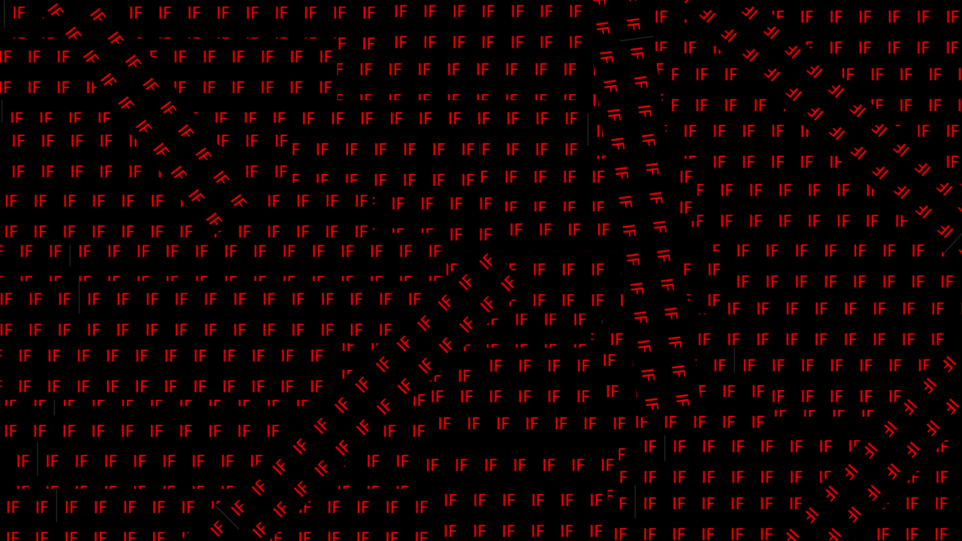

Slide 14
Your if’s are always describing something. So just call it what it is
Notes:
Syntactic sugar aside, it’s clear that abstracting out the logic from the if into a function allows for us to digest that information quickly, then if we need to understand the details we can.
It’s important to have information there to be consumed by people who need it, but not there for people that don’t. You don’t want to have to read and more importantly understand complicated logic if you have no use for it at that moment in time

Slide 15
Signal to noise wastes cognitive resource
Notes:
Redundant information just takes time and space

Slide 16
What’s the most dangerous code in source control?
Notes:
Yyyyyyyyyyyyyyyyyyyyyyyyyyyyyyyyyts comments

Slide 17
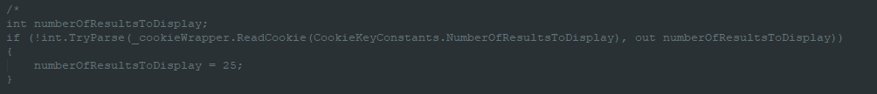
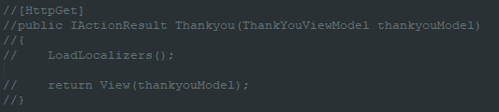
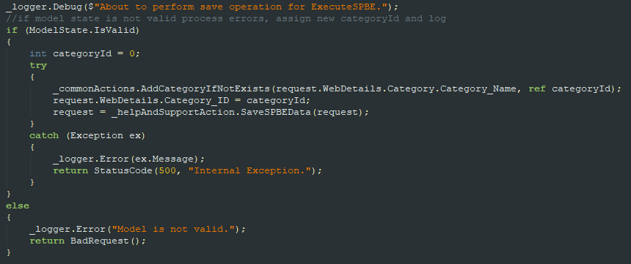
Commented out code should never be in source control.
Notes:
Explain the comments

Slide 18
The same goes for unused code
For the love of god; don’t future-gaze
If you write something that you don’t need, remove it
Notes:
Once code is committed it should be assumed it’s in use. Which means you need to be very bloody careful in removing it. Removing something that you’ve created locally before it’s in use takes far less time than investigating code usage

Slide 19


Death by a thousand
Line helper classes…
Logging in helps the user make an order…. Better put that logic in the OrderHelper class
Notes:
Helper classes suck, it immediately says that it is doing too much. You can almost guarantee the unit tests are going to be complex and need 1000s of fakes
Watch out for incognito helper classes. They’re normally classes with regions

Slide 20
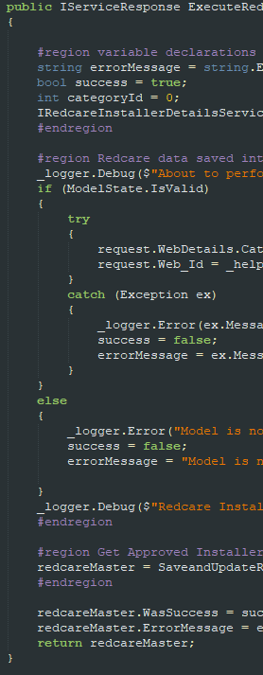
What’s worse than seeing regions separating methods?
Notes:
Just, why? Structuring this function would eliminate at least 1 region, the others could be functions themselves
20

Slide 21
Stupid quick summary
(as I want to leave time for questions)
Everything should describe itself
Variables
Functions
Classes
Use constants everywhere (if your language supports)
Please please please don’t use comments for source control
Actually, just use less comments in general
Less repetition
Don’t be afraid to refactor

Slide 22
Closing
Like anything it takes time
Lead by example
Create a coding standards charter for you and your team to hold each other accountable to

Slide 23
Questions?

